Slide 1
The Scientific Method in Everyday Life The Grocery Store
Notes:
Before beginning this module, it is HIGHLY recommended that students first review KTU’s Scientific Method module to preface the information they will be exposed to in this module. This module is applicable for all age groups; however, it would be highly beneficial for students to have a firm understanding of the scientific method prior to seeing it in a more advanced context.

Slide 2
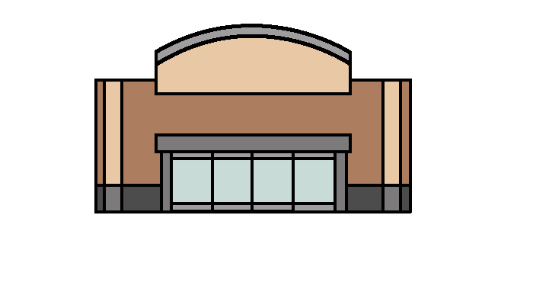
The Problem
You are the manager of a grocery store and you know that your store is going to be very busy, so you want to make sure that you have enough cashiers to check everybody out.
If your lines get too long your customers will get angry and maybe even leave. So it’s important that you keep the lines short.
If you hire too many cashiers then you will spend too much money.
Groceries

Slide 3
Background Research
You count and record the number of customers that come in to the store every day for 7 days. You get the following number of customers for each of the 7 days:
102 93 130 125 120 140 130
What is the average number of customers per day?
102 + 93 = 195
195 + 130 = 325
325 + 125 = 450
450 + 120 = 570
570 + 140 = 710
710 + 130 = 840 customers per week
2. If your store is open for 8 hours a day, how many customers come in per hour on average?
15
120 customers a day ÷ 8 hours a day =
120 customers a day
840 customers per week ÷ 7 days =
Notes:
This slide incorporates the first introduction of mathematics within the module. Students will not be able to move on past this slide until they have completed the two questions at the bottom. The first asks for the average from the number set above. If students are having any difficulty, make sure that they press the “solve” button to work through averaging step by step. After they find the average they can move on to the second question which asks for the average number of people that come in per hour into the store. This can be solved by dividing the initial average by the number of hours per day the store is operating. If they make it through all of the steps correctly, they should find the average number of people that come in per hour to the store and the “Continue Learning” button should appear to allow them to move on.

Slide 4
Background Research
You were able to determine that you have an average of 120 customers per day, and from this you calculated that an average of 15 people came to your store every hour.
Now how will we determine the number of cashiers that we will need to hire?
We need to do more background research and determine how many people a cashier can check out per hour. Then we can figure out how many cashiers we need to hire to serve 15 people per hour.
Groceries
Groceries
NOW HIRING
CALL: 867-5309

Slide 5
Background Research
You time your cashiers to see how long they take the check out to customers. You recorded the following five measurements
10 minutes 14 minutes 15 minutes 9 minutes 12 minutes
What is the average check out time in minutes?
72 min ÷ 6 = 12 min per customer
How many customers can a cashier check out per hour?
60 min ÷ 12 min per customer = 5 customers per hour
How many cashiers do you need to serve 15 people per hour?
15 people per hour ÷ 5 customers per hour = 3 cashiers per hour
Average: 10 min + 14 min = 24 min + 15 min = 39 min + 9 min = 48 min + 13 min = 61 min + 11min = 72 minutes
Notes:
This slide uses the exact same mathematical processes as the first Background Research slide, just with different number sets. Instead of finding the average number of customers per day, students will find the average time each cashier takes to checkout a customer. If students are still having difficulty with averaging, there is another “solve” button to walk them through step by step towards finding the average. Following the first averaging question is a second question that asks how many cashiers will be needed to serve a certain number of customers per hour. This question requires students to first find the number of customers a cashier can check out per hour (60 mins divided by the first average they found about checkout time per customer). Following this they need to divide the number of people per hour by the number of customers a cashier can check out per hour. If they make it through all of the steps correctly, they should find how many cashiers they will need and the “Continue Learning” button should appear to allow them to move on.

Slide 6
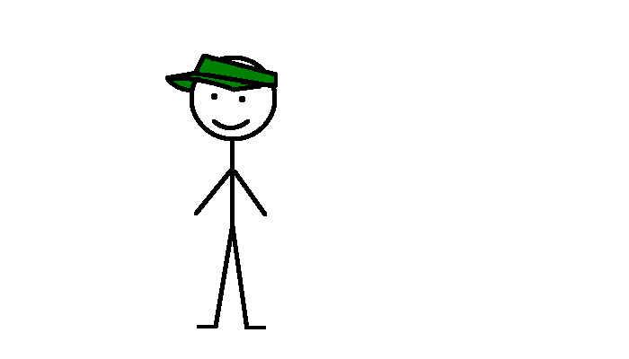
Hypothesis
In your research, you studied traffic at your store and found that if you hired 3 cashiers you would be able to handle the average flow of customers.
You form the following Hypothesis: If 3 cashiers are hired then the lines in the store will not back up because there will be enough cashiers to balance the demand of the customers.
Notes:
Since the student should have already reviewed KTU’s Scientific Method module, they should be familiar with the appropriate format for a hypothesis. This being said, make sure to emphasize the underlined “If”, “then”, and “because” statements to ensure that they learn to cover all of the variables and research required in the formatting of a hypothesis.

Slide 7
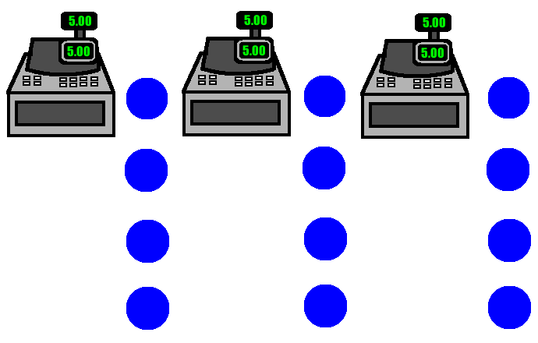
What Do We Expect to See
We made our hypothesis based on the idea that customers would show up evenly and be served evenly, with no delays. So we would expect to see something similar to the image below.
Customers in line
Notes:
If students are at all confused by the GIF animation provided on this page, make sure that they understand that this is a theoretical image of grocery store lines (the yellow dots are people and the cash registers are cashiers). The animation on this page is only present to help students visualize the hypothesis made on the previous page.

Slide 8
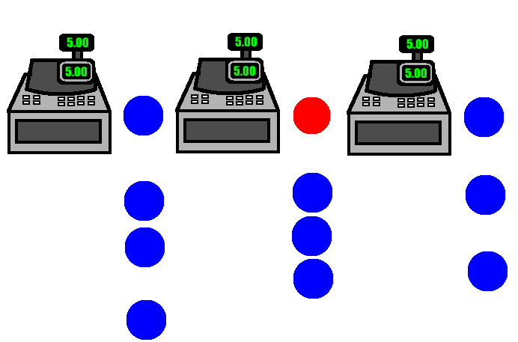
Experiment: Observe What Happens
When we go to watch our store we see that people show up randomly and delays happen in our lines. Instead of having smooth flowing lines, we have lines that build up and customers waiting.
Delay
Bunching
Notes:
Similar to the “What do We Expect to See” page, this page incorporates a GIF animation that displays the reality of grocery store lines (the red dot reading “delay”, indicates that lines are not flowing smoothly as we had assumed in our hypothesis).

Slide 9
Data
In this instance, your data is Qualitative. That means you don’t have numbers to work with. Instead, you have observed your store and noticed that you are getting backed up lines.
Qualitative Data: Deals with descriptions and does not use measurements. (Examples – Colors, Smells, Properties)
Quantitative Data: This data is measured quantities and involves numbers and units. (Examples – 3 miles, 12 seconds, 8 kilograms)
Examples:
This glass feels warmer than the other glass. (Qualitative)
It is 21 degrees Celsius. (Quantitative)
The fertilizer made the plants grow an average of 6 inches taller. (Quantitative)
His car was moving faster than the bus. (Qualitative)
There are 12.6 liters of water in this bucket. (Quantitative)
Notes:
This page builds upon the student’s current understanding of data by incorporating some differentiations in the form of qualitative vs. quantitative data. It is crucial that students understand this concept because it enforces the need for units. Students must answer all 11 qualitative vs. quantitative questions before moving on by clicking on the gray “Qualitative vs. Quantitative” button on the page. Once they have completed the questions the “Continue Learning” button should reappear and allow them to continue.

Slide 10
Conclusion
We are going to need more cashiers if we want to avoid line build ups.
We saw that 3 cashiers just wasn’t enough during rush times. So, how many cashiers should we hire?
It is difficult to predict since this involves the random arrival of people and random delays at the counters.
We will have to try several different numbers of cashiers and see which works best.
Groceries
NOW HIRING AGAIN
CALL: 867-5309
Notes:
Make sure students are aware that having experimental data prove their hypothesis as incorrect is OK. In fact, it typically leads to better questions and experiments that will help them learn more about what they are researching.

Slide 11
Experiment
We are going to perform another experiment, this time trying different numbers of cashiers and observing which is most profitable. At the end of the experiment, we will know the best number of cashiers to have working.
In order to better compare the different trials, we are going to collect quantitative data this time. We are going to look at how much money we make at the end of the day.
If three cashiers was not enough, how many cashiers do you think will be the best number for the store?
Notes:
The scientific method is NOT linear; it is continuous. Since the first conclusion proved the initial hypothesis to be incorrect, it is necessary to refine the research further by trying a different experiment. The student will be asked to make a “guess” as to how many cashiers will be enough, knowing now that 3 cashiers was insufficient. When the student makes a guess, the “Continue Learning” button should appear to allow the student to move on.

Slide 12
Perform the Experiment
Look at the following results from your experiment and decide how many cashiers was most profitable:
Profit vs. Number of Cashiers
Cashiers | Profit | Unhappy Customers
3 | $ 756 | 18
4 | $ 838 | 8
5 | $ 843 | 2
6 | $ 781 | 0
7 | $ 704 | 0
8 | $ 585 | 0
9 | $ 492 | 0
Notes:
After the student has clicked the “Run Experiment” button and received the results from their theoretical experiment, they should be taking a look at all of the data that appears. Although there will be quite a bit to look at, the emphasis should be looking to the bar graph to see which number of cashiers yielded the highest profit. If the bar graph appears to display a tie between two different numbers of cashiers, make sure students look at the table to check the Profits that coordinate with the numbers. Even though the bar graph may appear to have two very close values, the number values can be distinguished more clearly in the table. Once the student has identified the optimal number of cashiers and submitted their answer, the “Continue Learning” button should appear to allow them to continue.

Slide 13
Analyze the Data
You found in your experiment that having 5 cashiers had the highest profit. Was your first guess close?
Do these results surprise you?
How did hiring more cashiers help you to make more money?
Look at the number of customers that left for each number of cashier that you had. How does this change as you hire more cashiers?
This is an example of Queuing Theory, which is the study of how lines move. According to Queuing Theory, you need a few more cashiers than what you expect from the averages to make sure that lines don’t build up and you can serve customers quickly and efficiently.
Notes:
Take time to discuss the questions on this page with your student(s). It will give them an introduction into the final portion of the module. It is important that they also understand the concept of unhappy customers leaving as part of the data analysis.

Slide 14
Conclusions
There are some interesting things that we can learn about this simple experiment.
We discovered that having enough cashiers to handle the average customer flow is not enough to always be able to avoid random line backups that lead to customers leaving.
The solution was to hire a few more cashiers than we calculated we would need. This is so we can handle the times that our store is overloaded.
Overloaded means we have more customers than we can handle.

Slide 15
Conclusions
The number of customers leaving went down as we increased the number of cashiers.
More cashiers meant that your store was able to handle more customers without the lines backing up too much.
This kept customers from leaving and taking their business elsewhere.
Ultimately, your store made more money by hiring more staff.
Notes:
Discuss the topics on this page as well as those on the “Conclusion 1” page to help students see that data can be multifaceted and lead to multiple discoveries. However, encourage them to use the facts they learn from experimentation to develop a final conclusion that focuses solely on their initial hypothesis.

Slide 16
Queueing Theory In Cells
Using a limited amount of resources in an effective way to make as much of a product as possible is known as energy efficiency. Can you think of other places where it might be important to be efficient with resources?
How about in Cells?
Problem: Cells have a limited number of resources and energy but have many jobs that they must complete in order to stay alive. To reduce the “costs” in a cell, the cell has to find better ways to do jobs that require a lot of energy.
Solution: Just like in our grocery store experiment, cells have to complete as many jobs as possible by using the right number of resources to keep themselves from being overloaded and having “lines” build up. However, Cells also have to make sure that they can “afford” the right number of resources.

Slide 17
Topics for Discussion
Is there a better way to line people up at the registers?
If we call the store overloaded when we have too many customers to serve, what do we call the store when we have more cashiers than we need?
When you originally calculated that you needed 3 cashiers, you were assuming that your store would always be critically loaded. What do you think Critically Loaded means?
What could you do as the manager to help out your cashiers in an overloaded situation? What would you do when they were underloaded?

